Slide 1
VIVO (RT8901)
massage chair
Service Manual

Slide 2
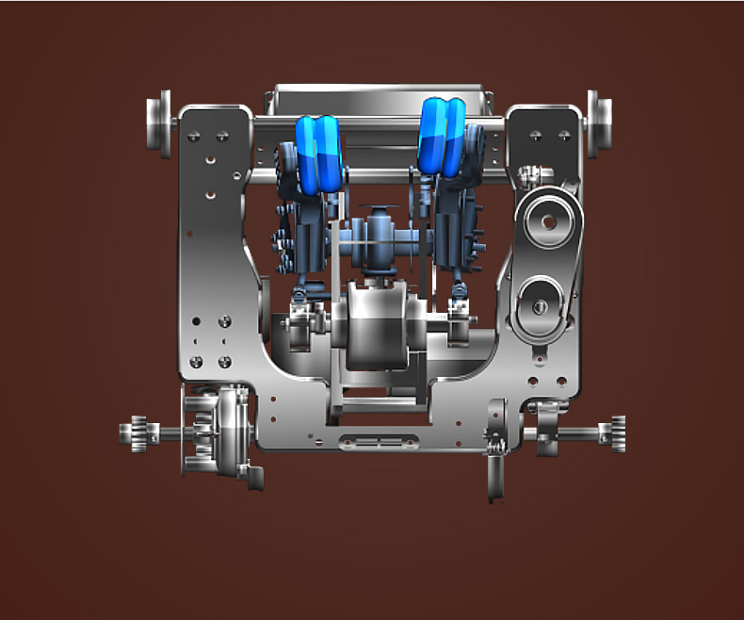
Mechanism
Upper mech
Trip
Overlapping Trip
Lower mech
Trip

Slide 3
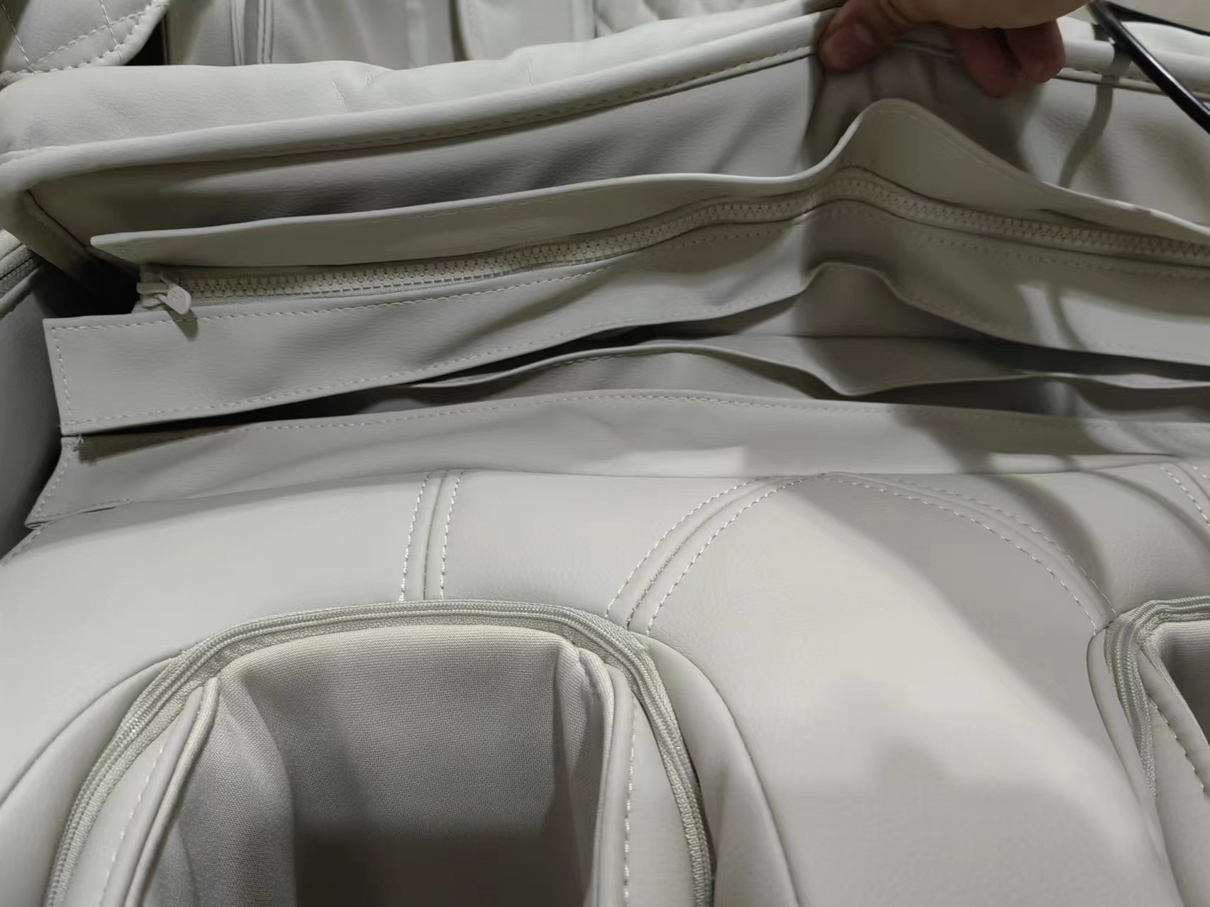
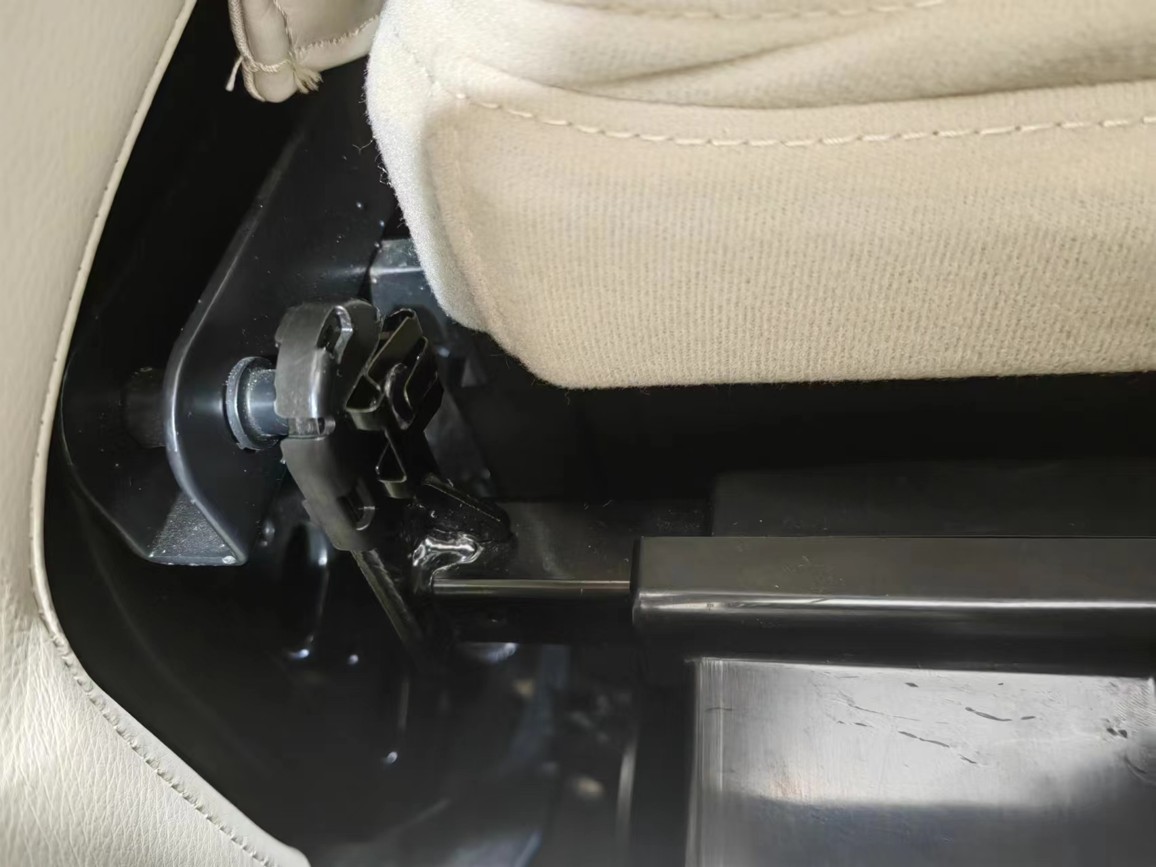
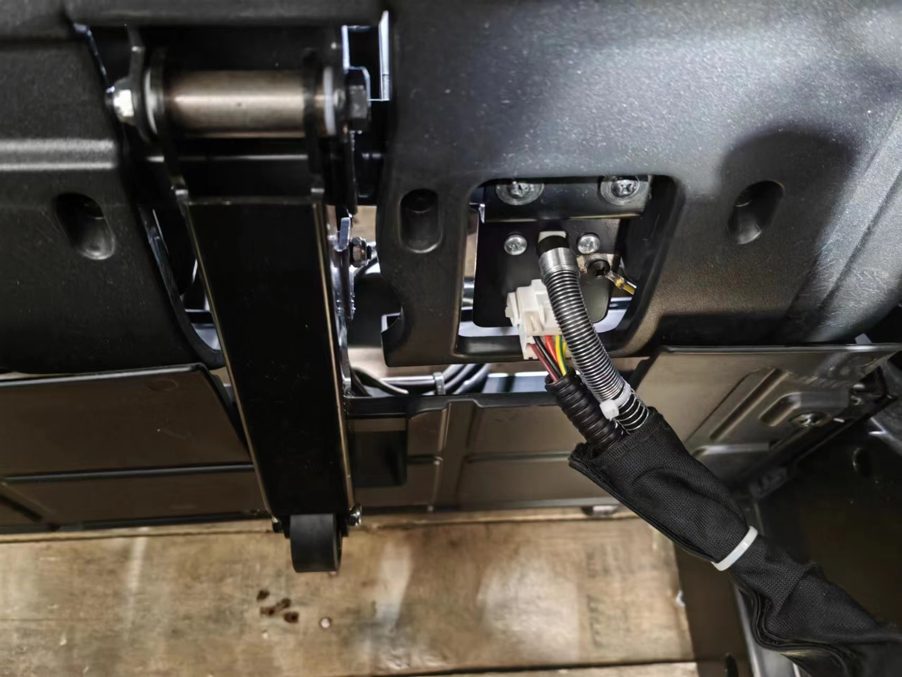
Legrest uninstall
Pic.1
Pic.2
Pic.3
Unzip the legrest cover from back cushion as Pic.1
Take off clips on both sides as Pic.2
Take off legrest’s air tube & wire connection from chair body as Pic.3

Slide 4
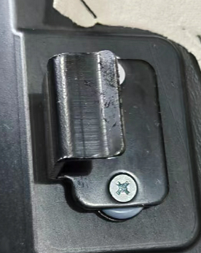
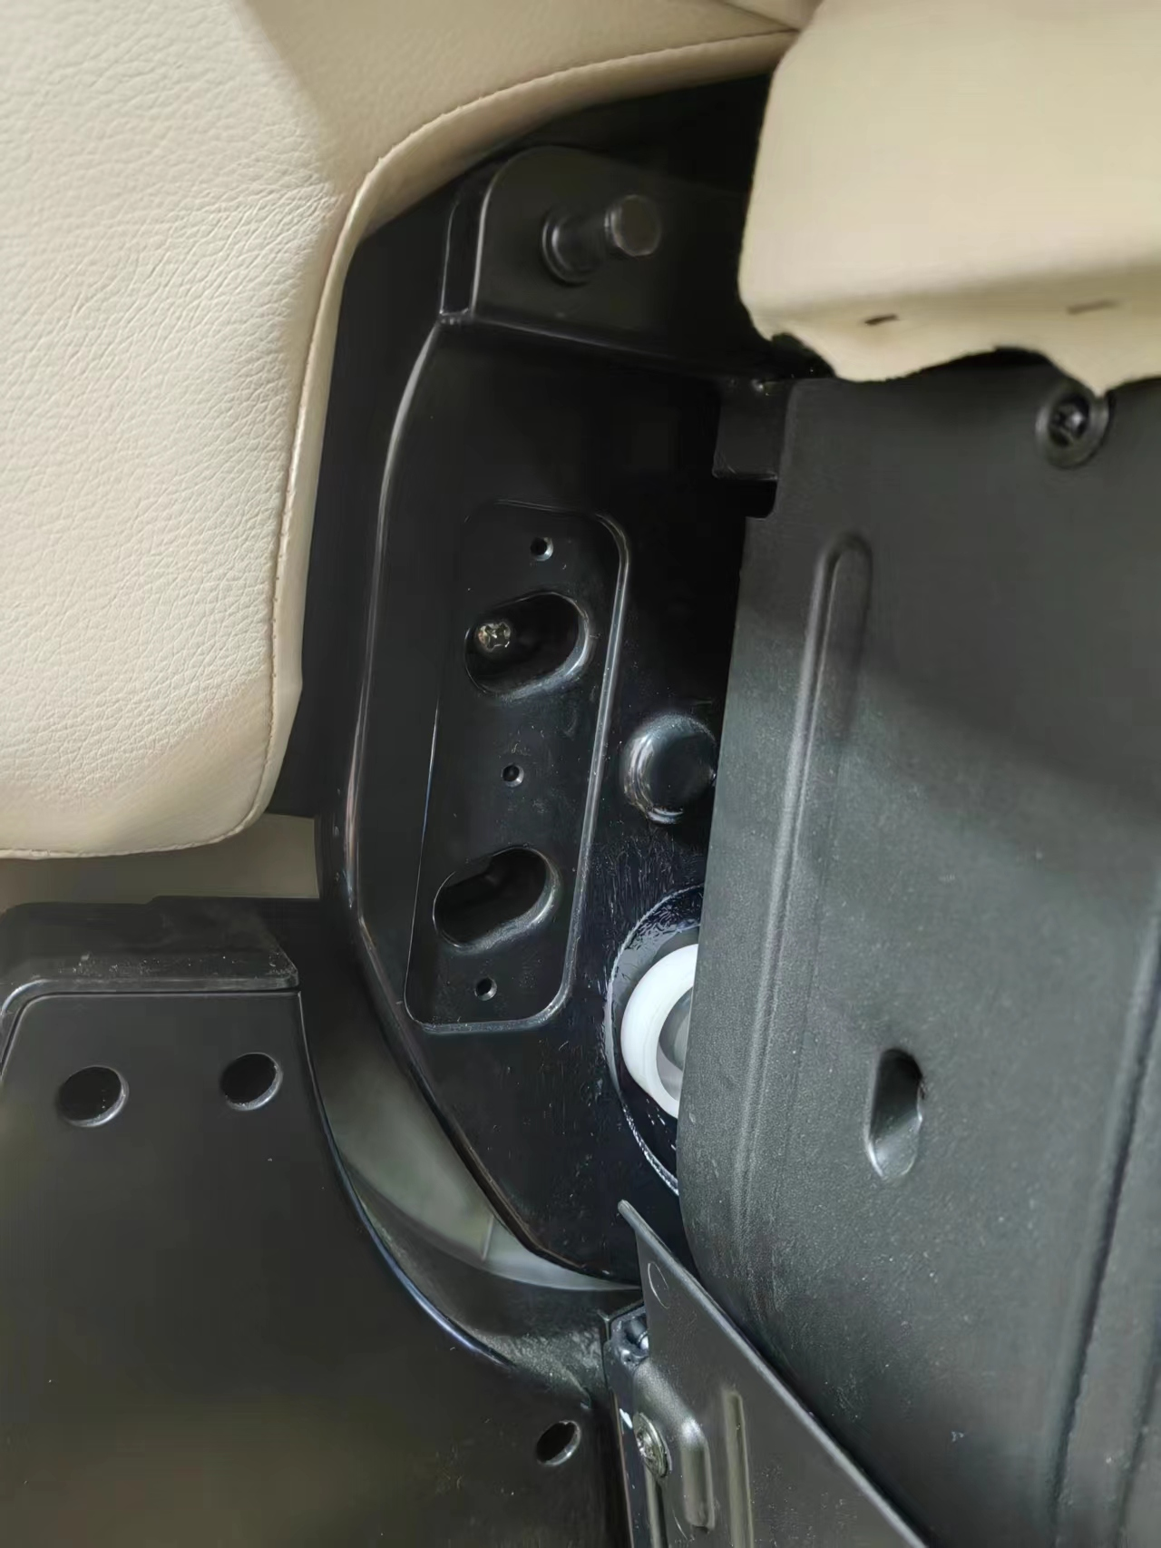
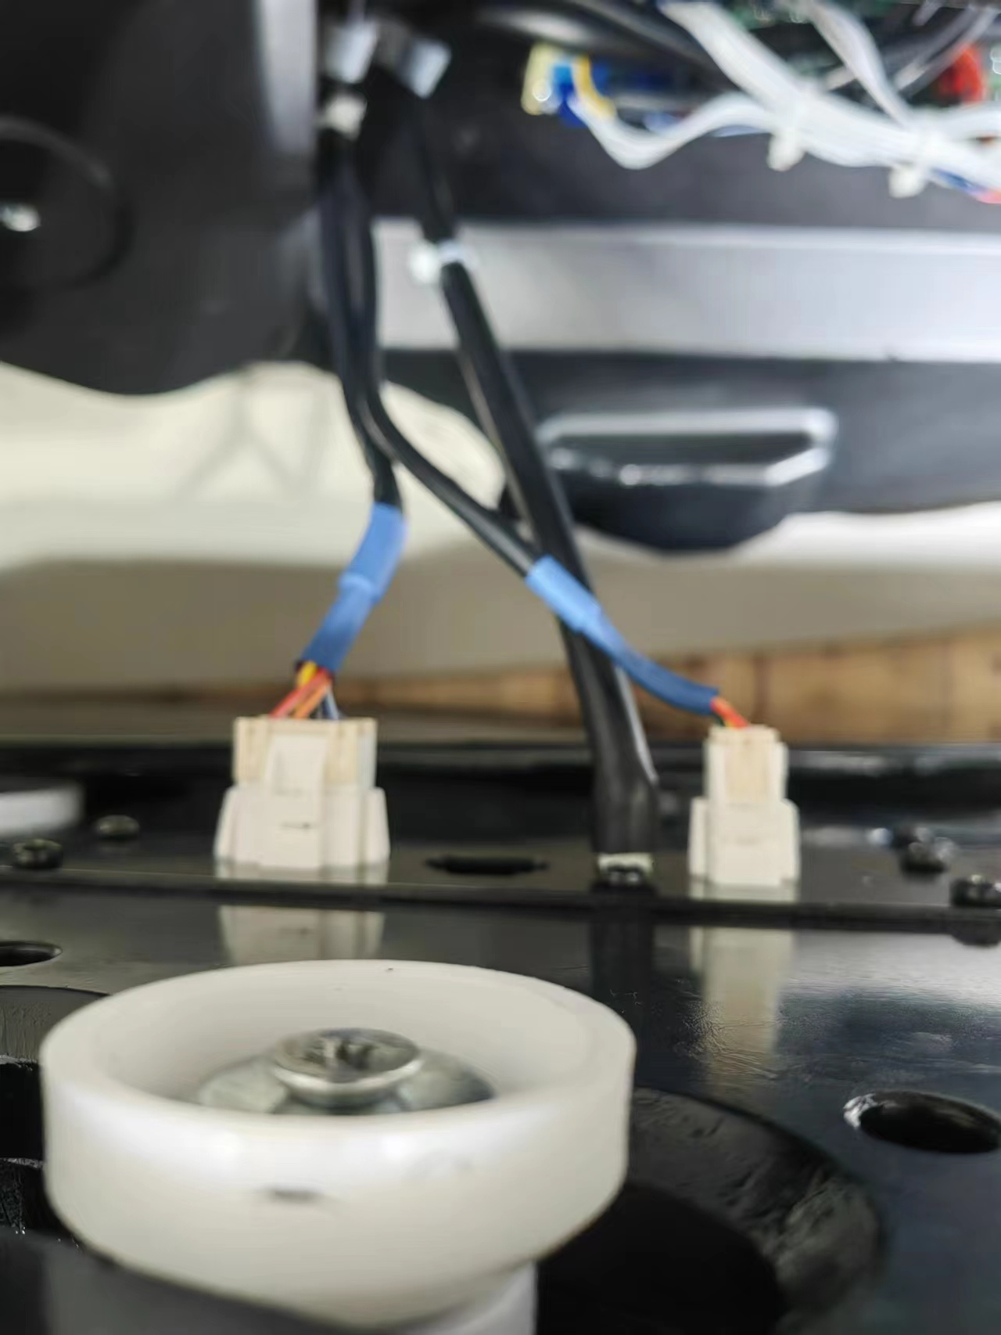
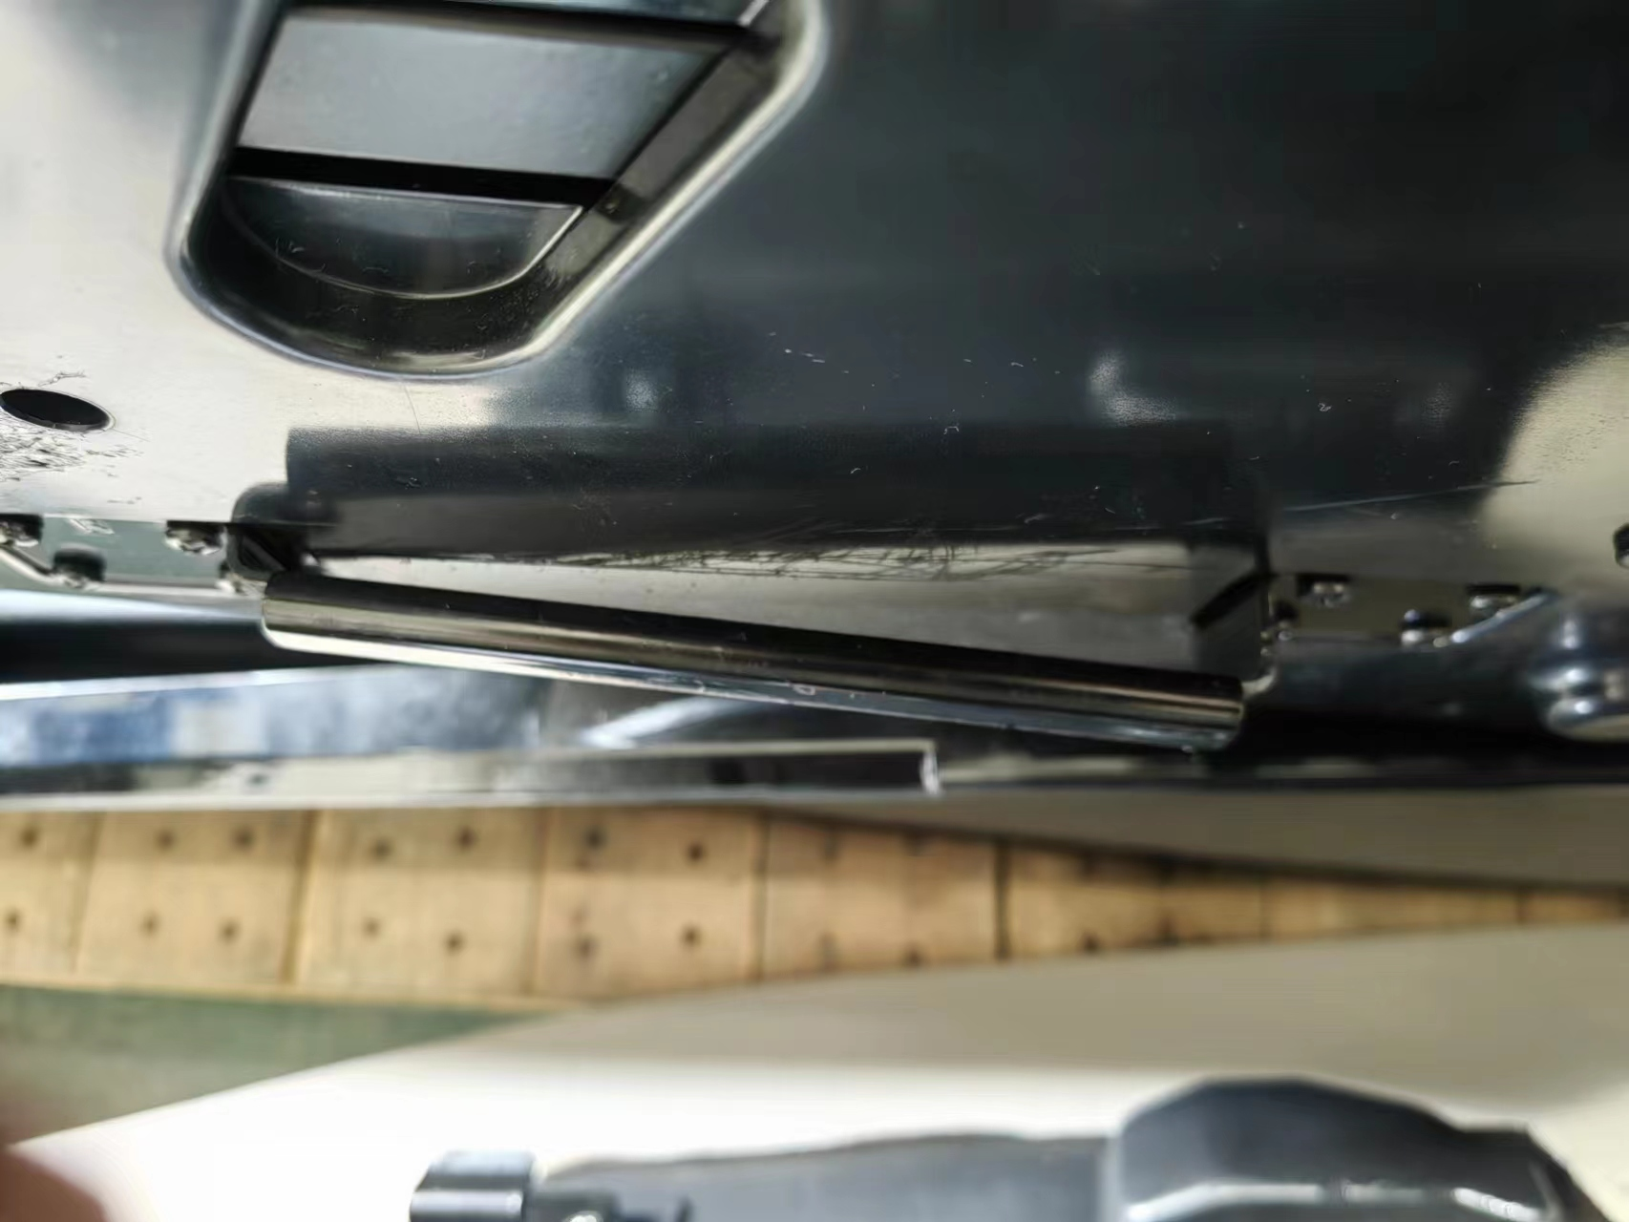
Armrest uninstall
Pic.1
Pic.2
Pic.3
Remove screws at the front end of armrest as Pic.1
Take off air tube & wire connection from chair body as Pic.2
When installing, the iron frame on the armrest should be stuck in the card slot of the chair body as Pic.3

Slide 5
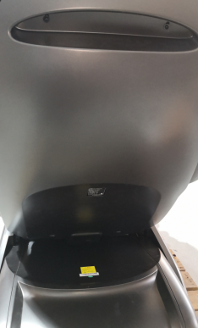
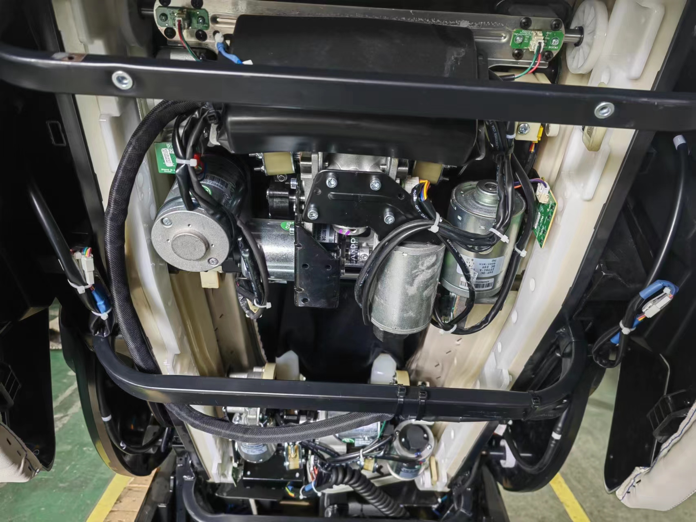
Head cover uninstall
Pic.1
Pic.2
Pic.3
Pic.4
Remove screws on back cover as Pic.1
Cut off cable tie and take off wire connection as Pic.2
Unzip shoulder airbag cover as Pic.3
Remove screws on head cover to take it off as Pic.4

Slide 6
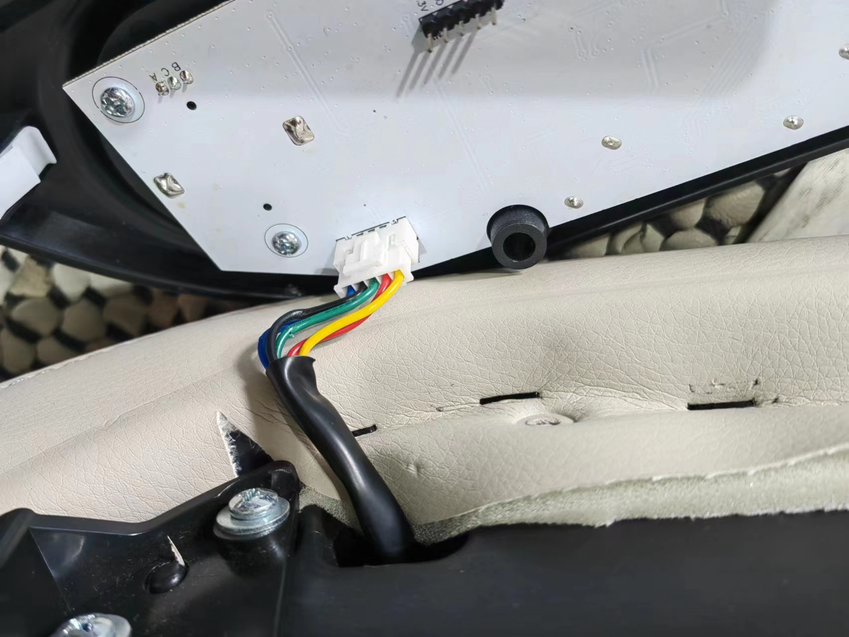
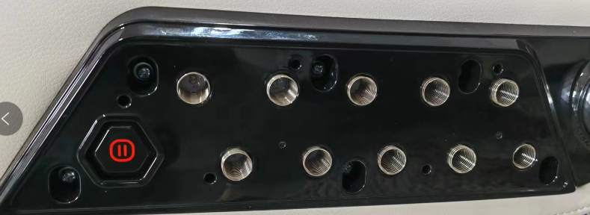
Keyboard PCB uninstall
Pic.1
Pic.2
Pic.3
Pic.4
Lift keyboard plate as Pic.1
Remove the screws as Pic.2
Take off connection as Pic.3
Remove screws as Pic.3

Slide 7
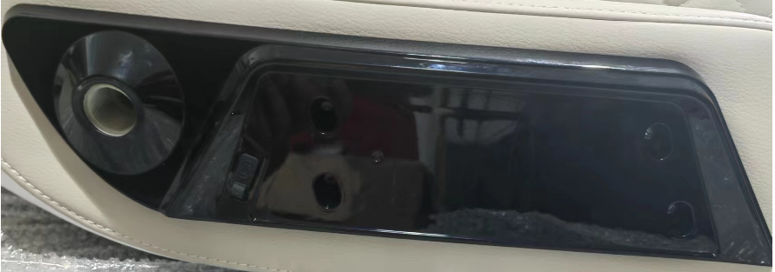
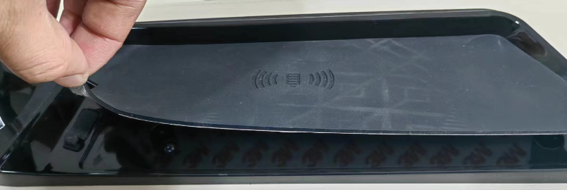
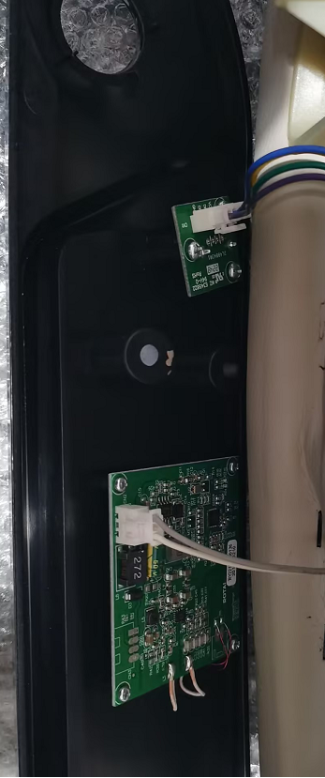
Charging PCB uninstall
Pic.1
Pic.2
Pic.3
Tear off rubber plate as Pic.1
Remove screws as Pic.2
Take off connection as Pic.3

Slide 8
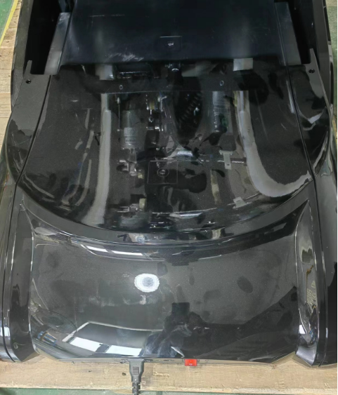
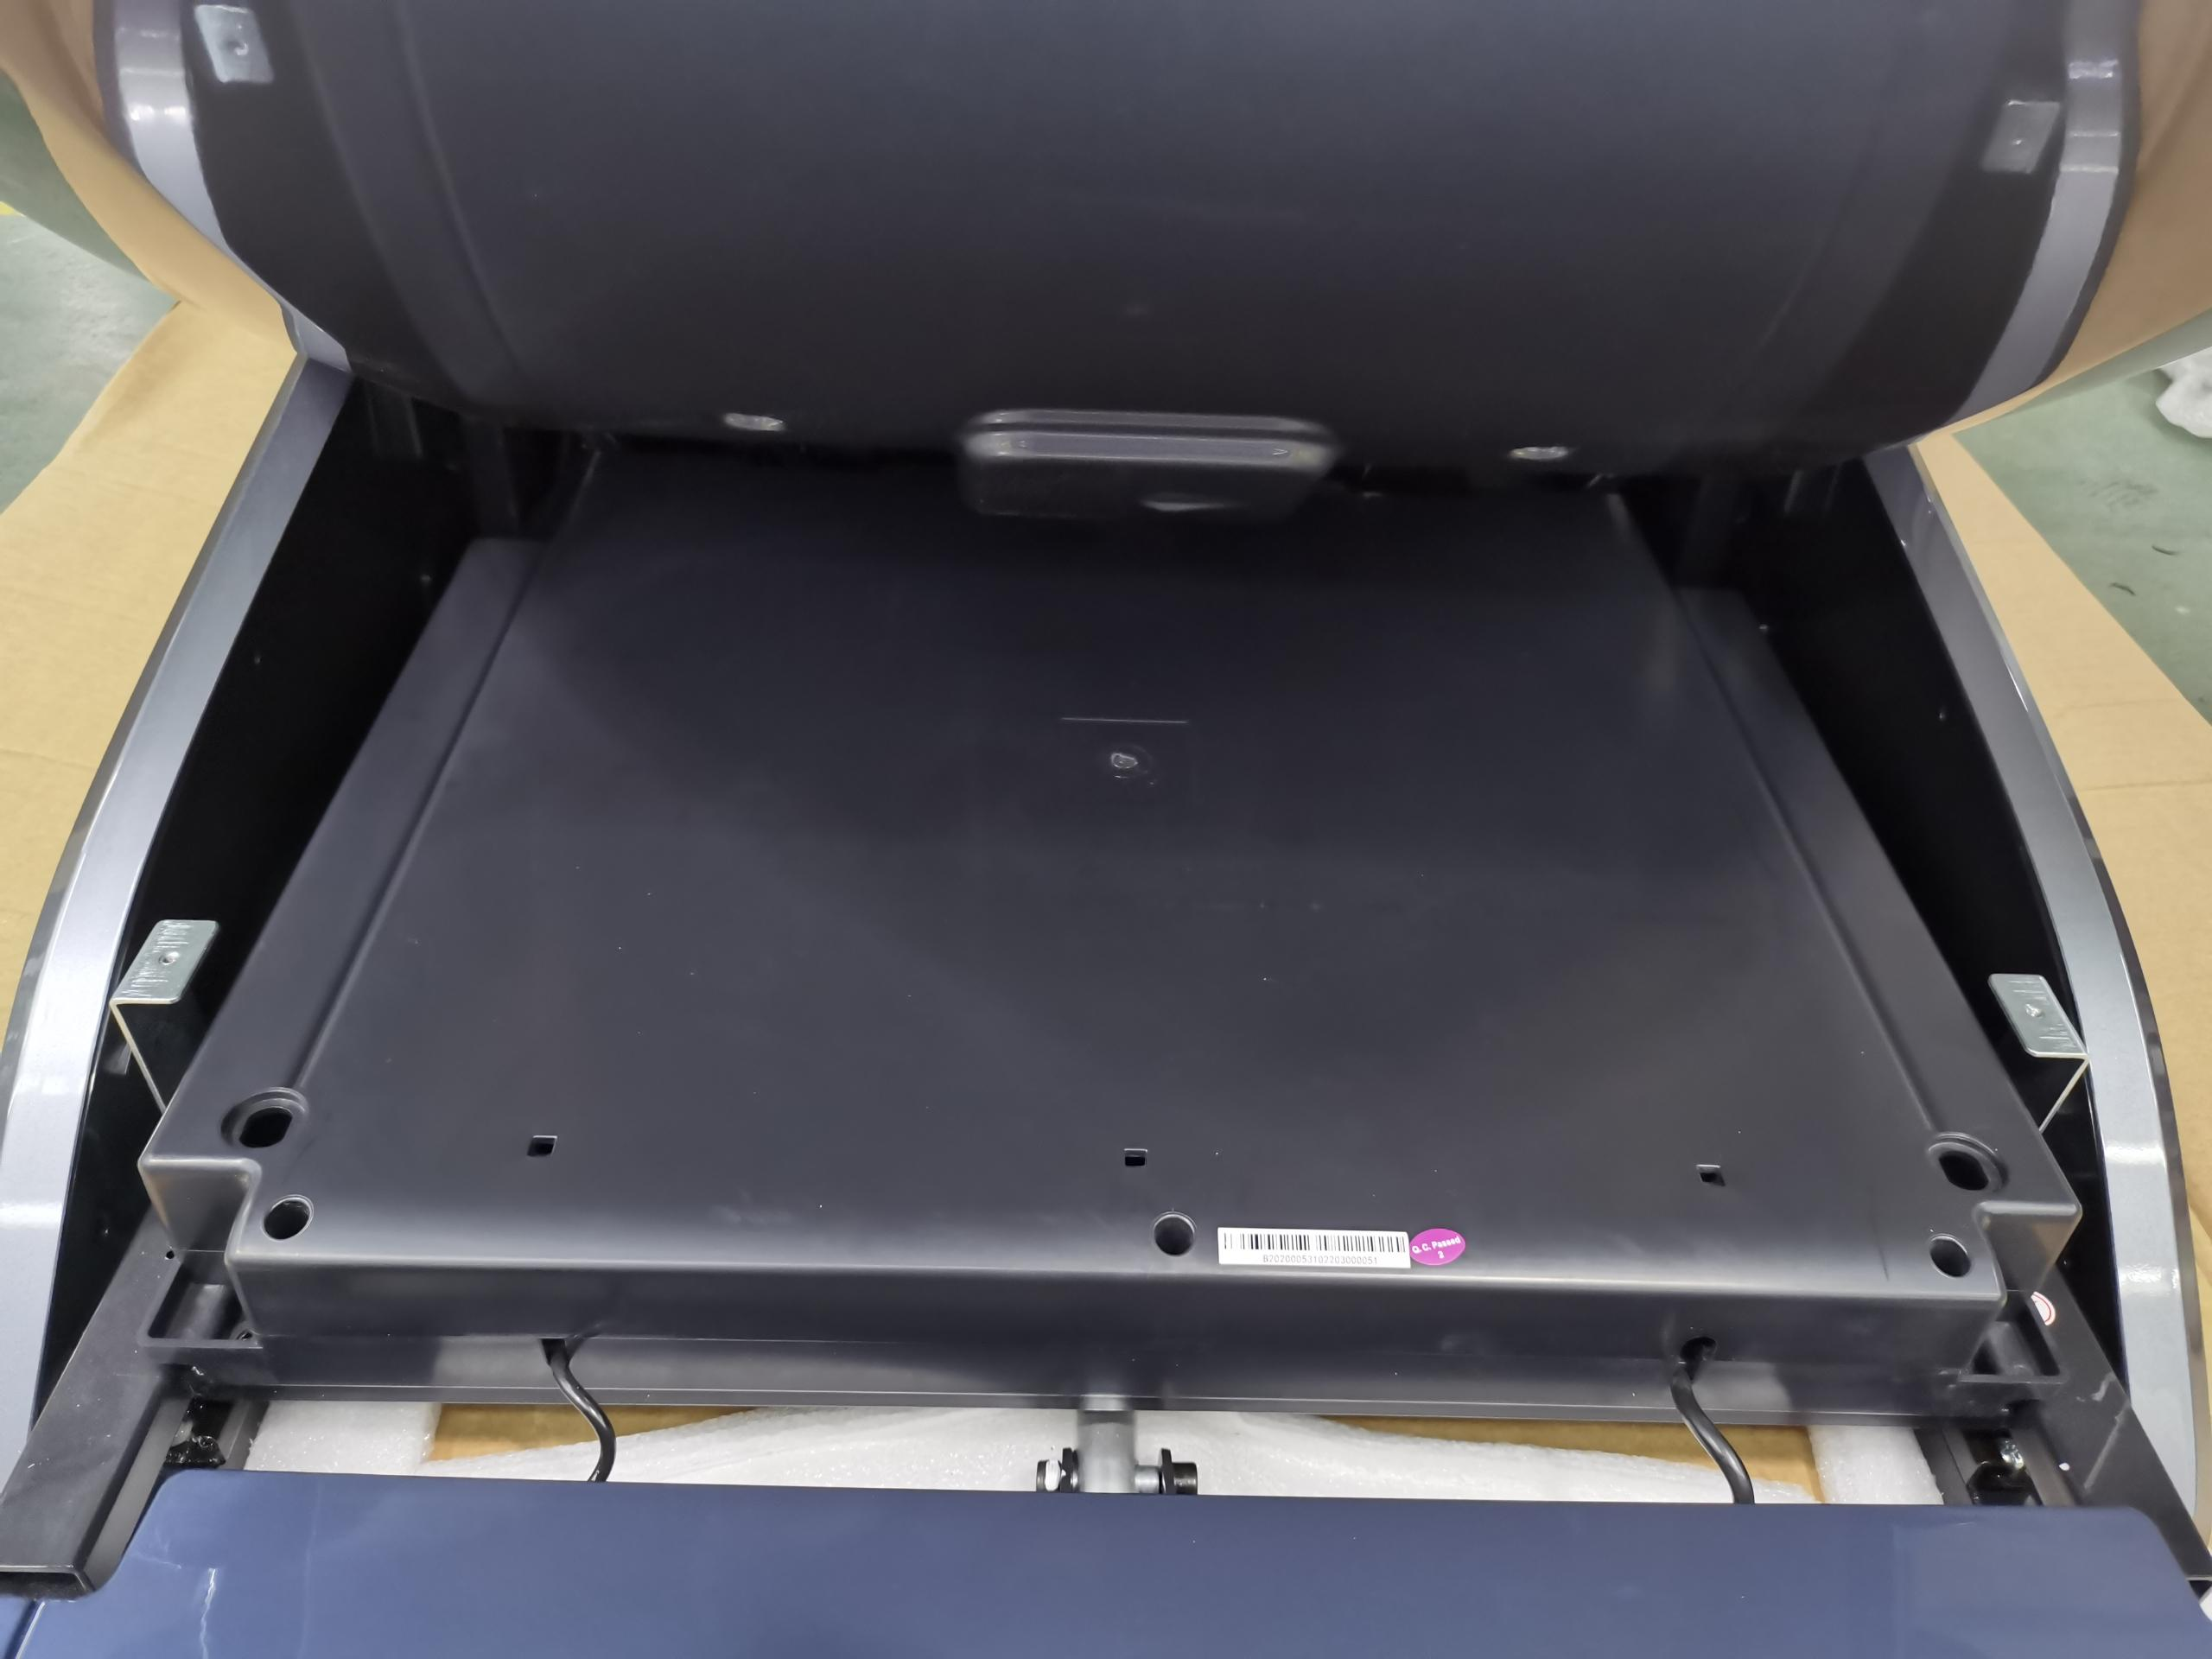
Power box cover uninstall
Pic.1
Pic.2
Remove 3 screws as Pic.3
Remove 2 screws as Pic.1

Slide 9
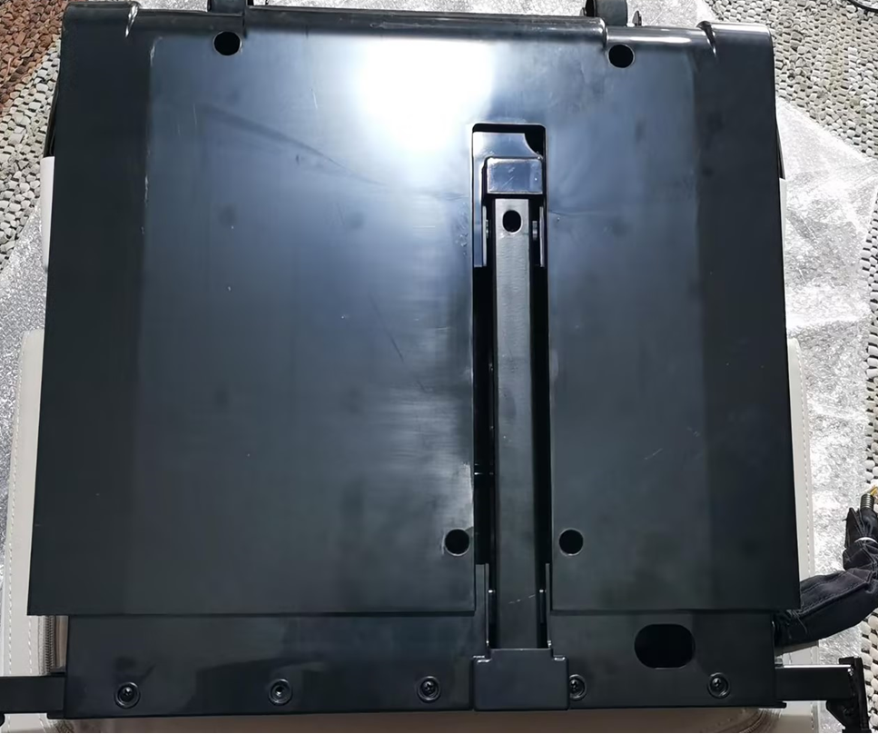
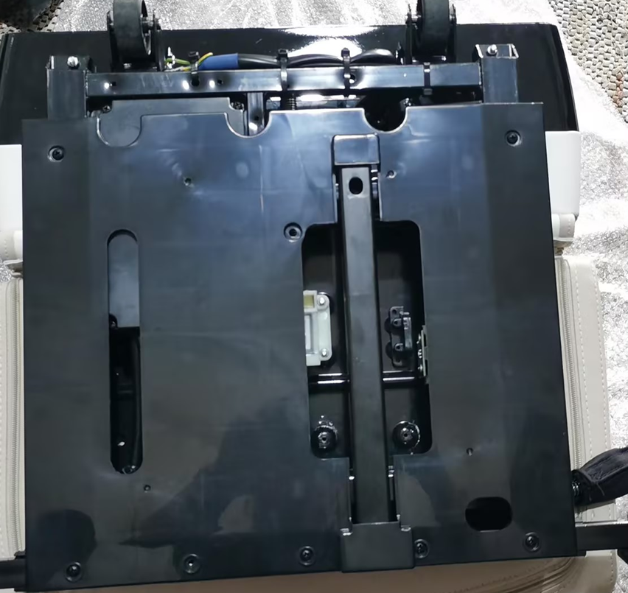
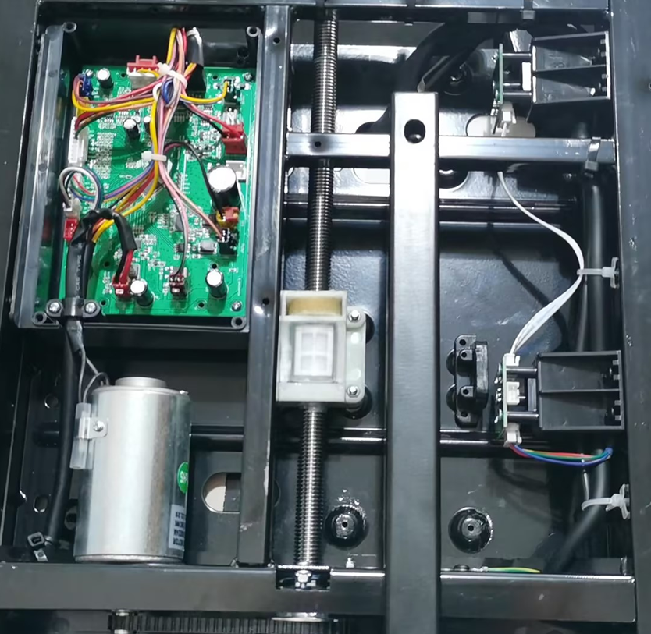
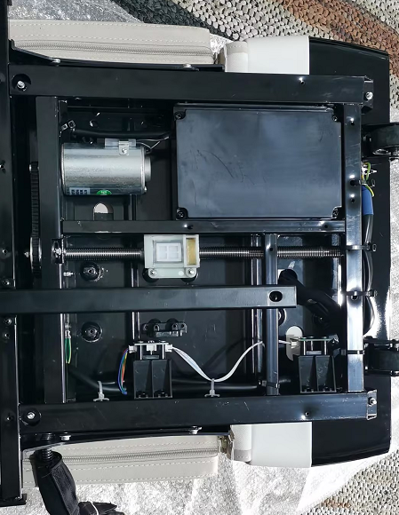
Legrest PCB uninstall
Pic.1
Pic.2
Pic.3
Pic.4
Remove 4 screws as Pic.1
Remove 8 screws as Pic.2
Remove 4 screws as Pic.3
Take off connection，Remove 4 screws as Pic.4

Slide 10
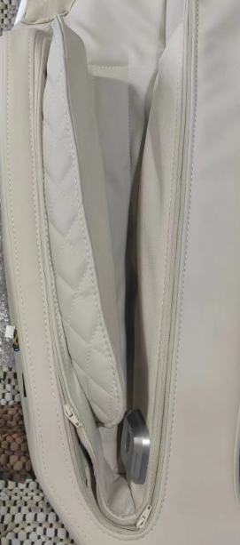
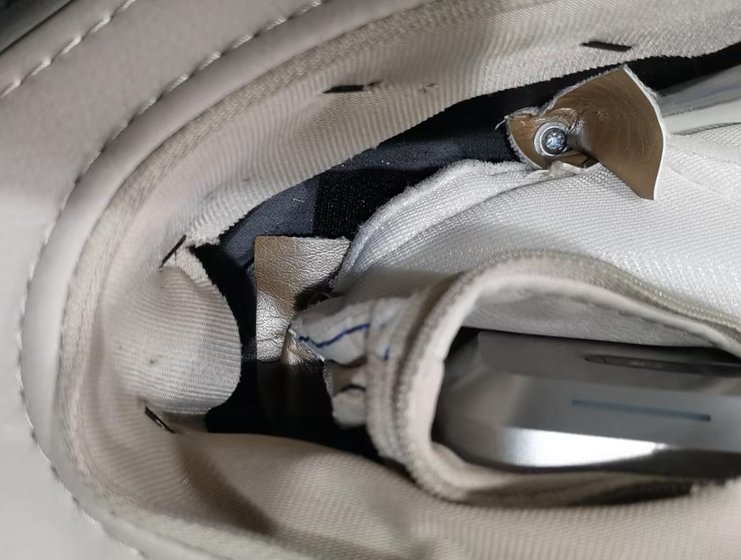
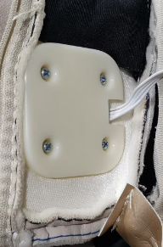
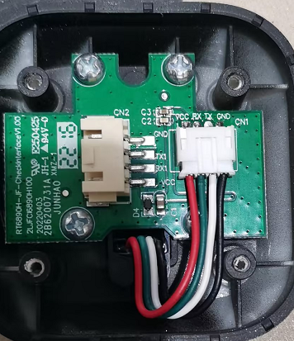
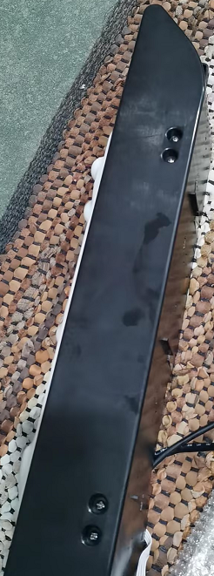
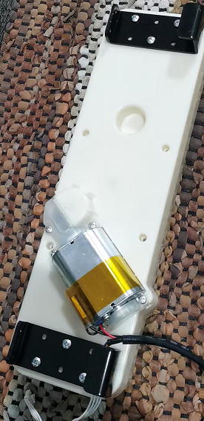
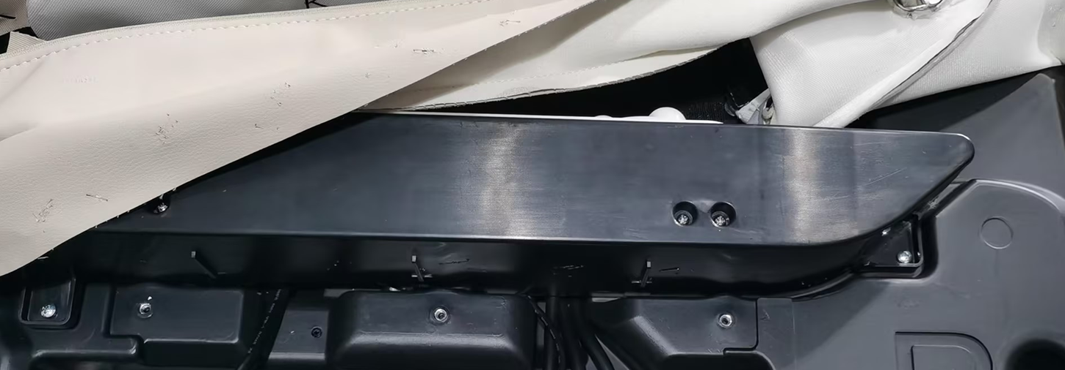
Arm motor uninstall
Pic.1
Pic.2
Pic.3
Pic.4
Pic.5
Pic.6
Pic.7
Pic.8
Unzip arm PU cover as Pic.1
Remove 2 screws as Pic.2
Remove 4 screws as Pic.3
Take off connection as Pic.4
Remove 3 screws as Pic.5
Take off nails from leather as Pic.6
Remove 4 screws as Pic.7
Remove motor as Pic.8

Slide 11
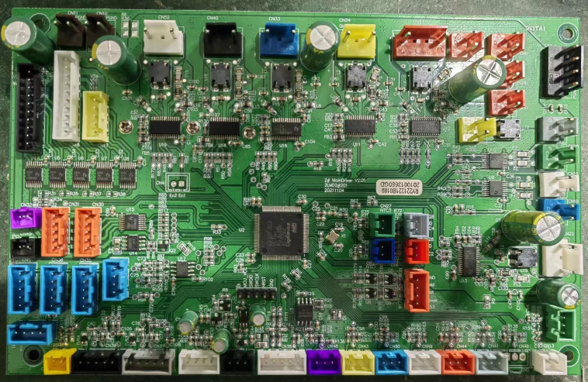
Main PCB instruction Pic.
Upper chair Bump
Zero gravity actuator
Forward actuator
Legrest actuator
Legrest Bump
DC24V Left Armrest
DC24V Legrest
DC24VMechanism
DC24V Right Armrest
DC24V Power in
Leftvalve
Rightvalve
speaker Left Lights
speaker Right Lights
Back heating
485Comm Mechanism
Backrest actuator
485Comm Left Armrest
485Comm Right Armrest
Left Anti-clamp
485Comm Legrest
485Comm voice control
Main PCB
Comm
Power box Anti-clamp
APP
5V Power
Forward count
Zero gravitycount
Backrest count
Legrest count
Head cover Anti-clamp
Right Anti-clamp

Slide 12
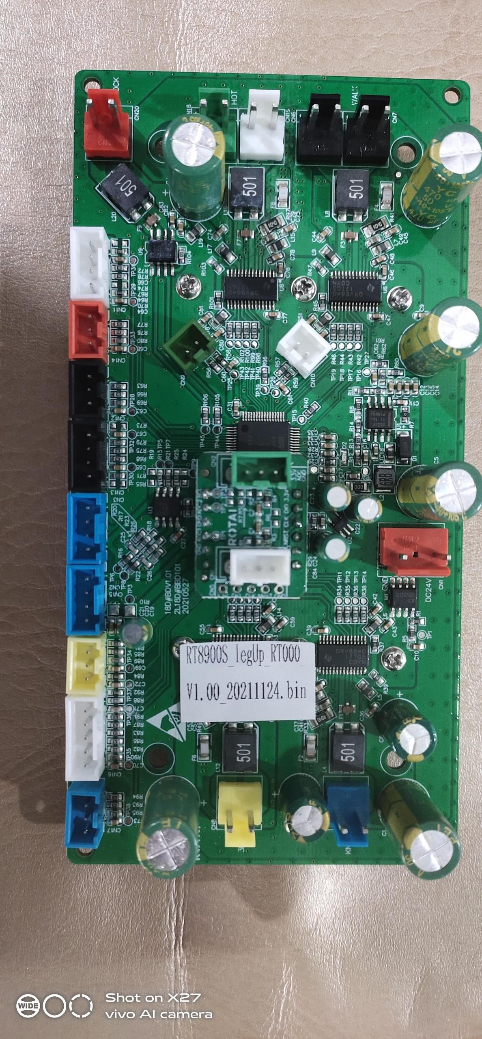
Upper Mechanism InstructionPic.
Massage force sensor
DC24 input
walk motor test connection
knead motor connection
walk motor connection
3D radial motor connection
knock motor connection
knead count signal connection
Mechanism travel signal limit
3D limit signal connection
Mechanism Comm signal connection
3D count signal connection
knock count signal connection
Anti-crash signal connection
Wide-mid-narrow

Slide 13
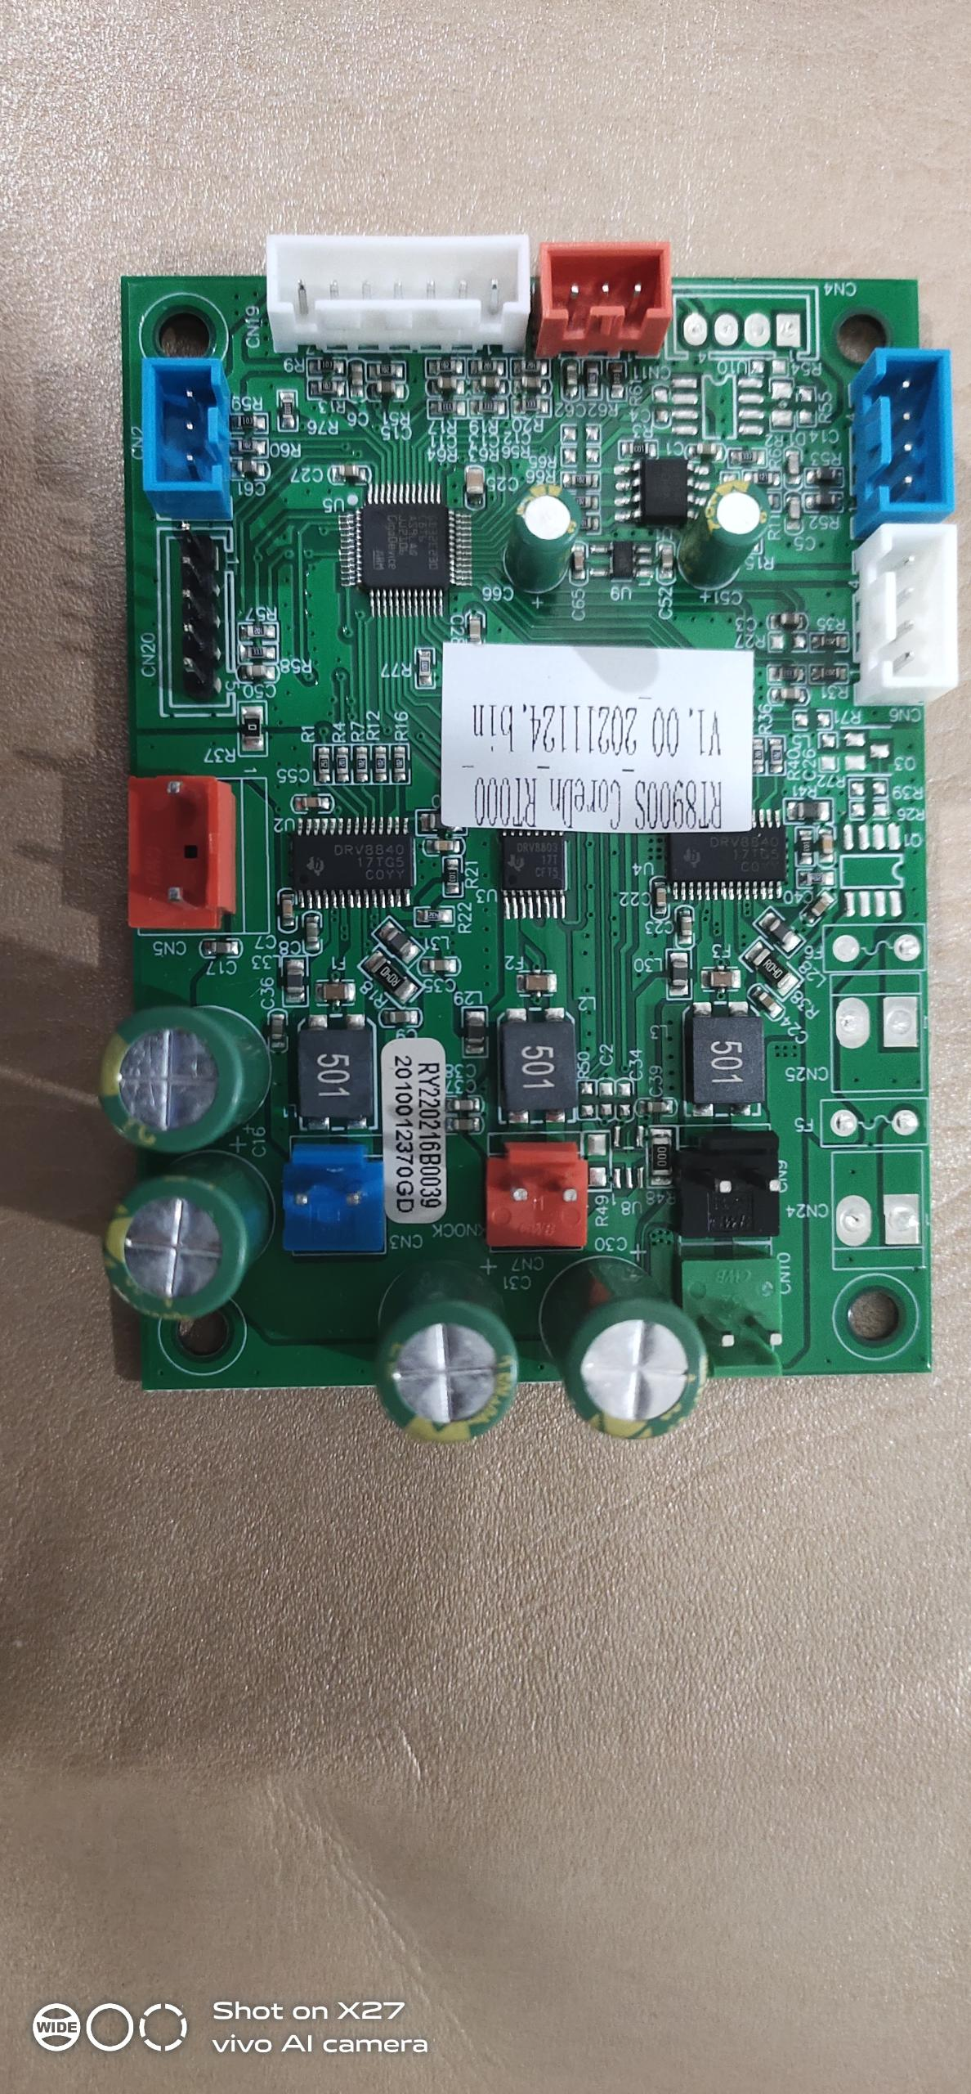
Lower Mechanism Instruction Pic.
DC24 input
knead count signal connection
knead motor connection
Width signal connection
knock motor connection
walk motor test connection
knock count signal connection
walk motor connection
walk motor travel limit signal connection
Mechanism Comm signal connection

Slide 14
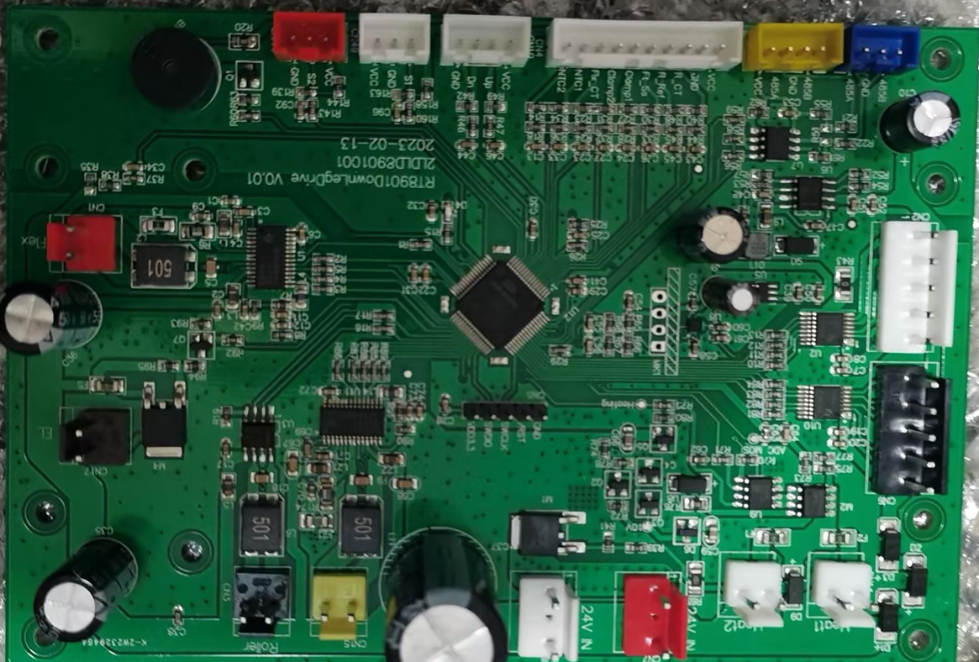
Legrest main PCB connection Instruction Pic.
Legrest DC24V output
DC24V input
Legrest rubbing motor
Foot roller motor
Lower Legrest valve
Legrest lights connection
Upper Legrest valve
Legrest extend motor
485 Comm connection
DC5V signal connection
extend limit signal connection
Legrest rubbing signal connection

Slide 15
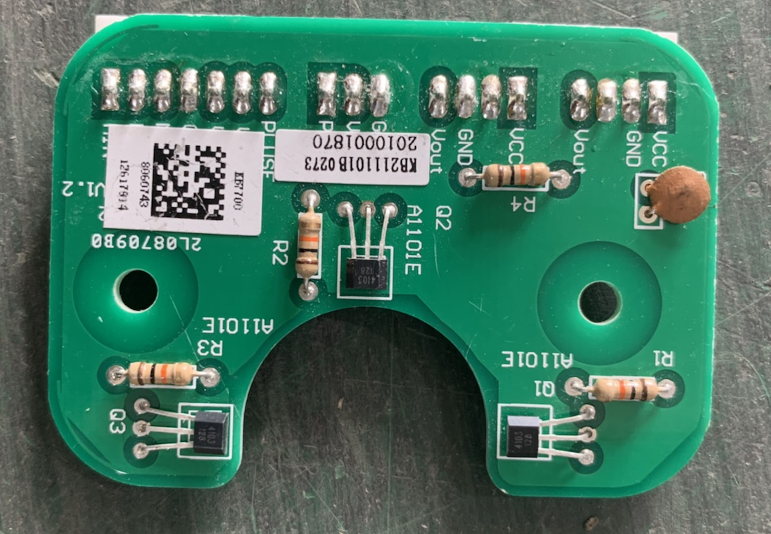
Up Mech Width CPB，Low Mech Width PCB，3D limit PCB，3D count PCB，Mech travel limit PCB connection，Massage force sensor PCB
walk count connection
walkcountconnection
LeftRight曲臂体测connection
Widthconnection
3Dlimitconnection
Width connection
up Mech Width PCB
Low Mech Width PCB
3DlimitPCB
Massage force sensor connection
Up Mech travel limit PCB connection
Low Mech travel limit PCB connection
3Dcountconnection
3D count PCB
Massage force sensor connection
Up Mech travel limit PCB
Low Mech travel limit PCB

Slide 16
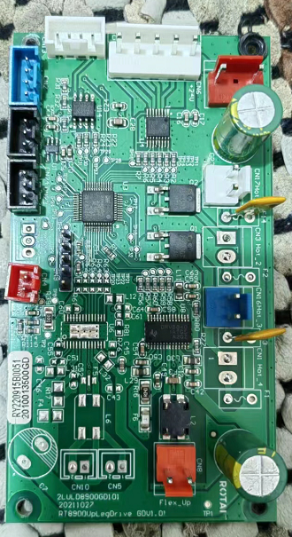
Left & Right Armrest PCB
485Comminput
485Comminput
Armrestvalveconnection
Armrestvalveconnection
Armrestmotor
DC24Vinput
DC24Vinput
Armrestmotor
DC24V充电

Slide 17
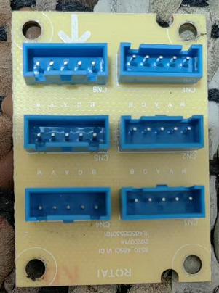
Health detect PCB，5V PCB
485 Comm Right Armrest PCB output
485 Comm input
485 Comm Armrest keyboard PCB output
485 Health detect Comm output
485 Comm input
Health detect Comm

Slide 18
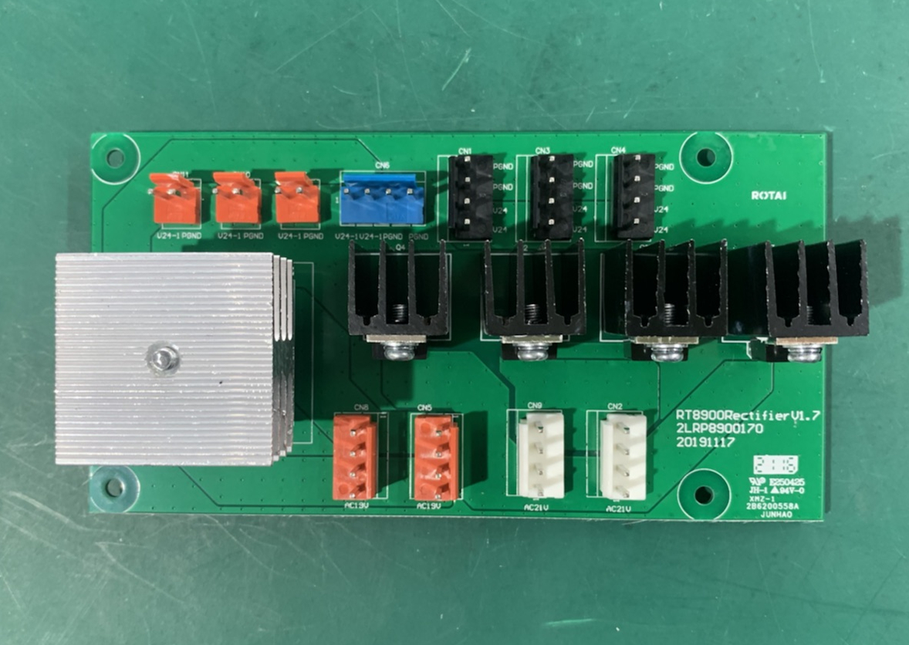
Rectifier connection Instruction Pic.
DC24V connection to Left Armrest charging
DC24V connection to main PCB
DC24V connection to Legrest
DC24V connection to Mechanism
AC21V connection 5A transformer
AC21V connection to Bump

Slide 19
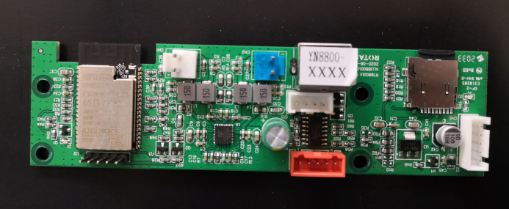
BT board，5V Power PCB InstructionPic.
speaker connection
speaker connection
Remote outlet
AC110V output
5V power output
APP signal connection
connection to Main PCB
AC110V input
5V power PCB

Slide 20
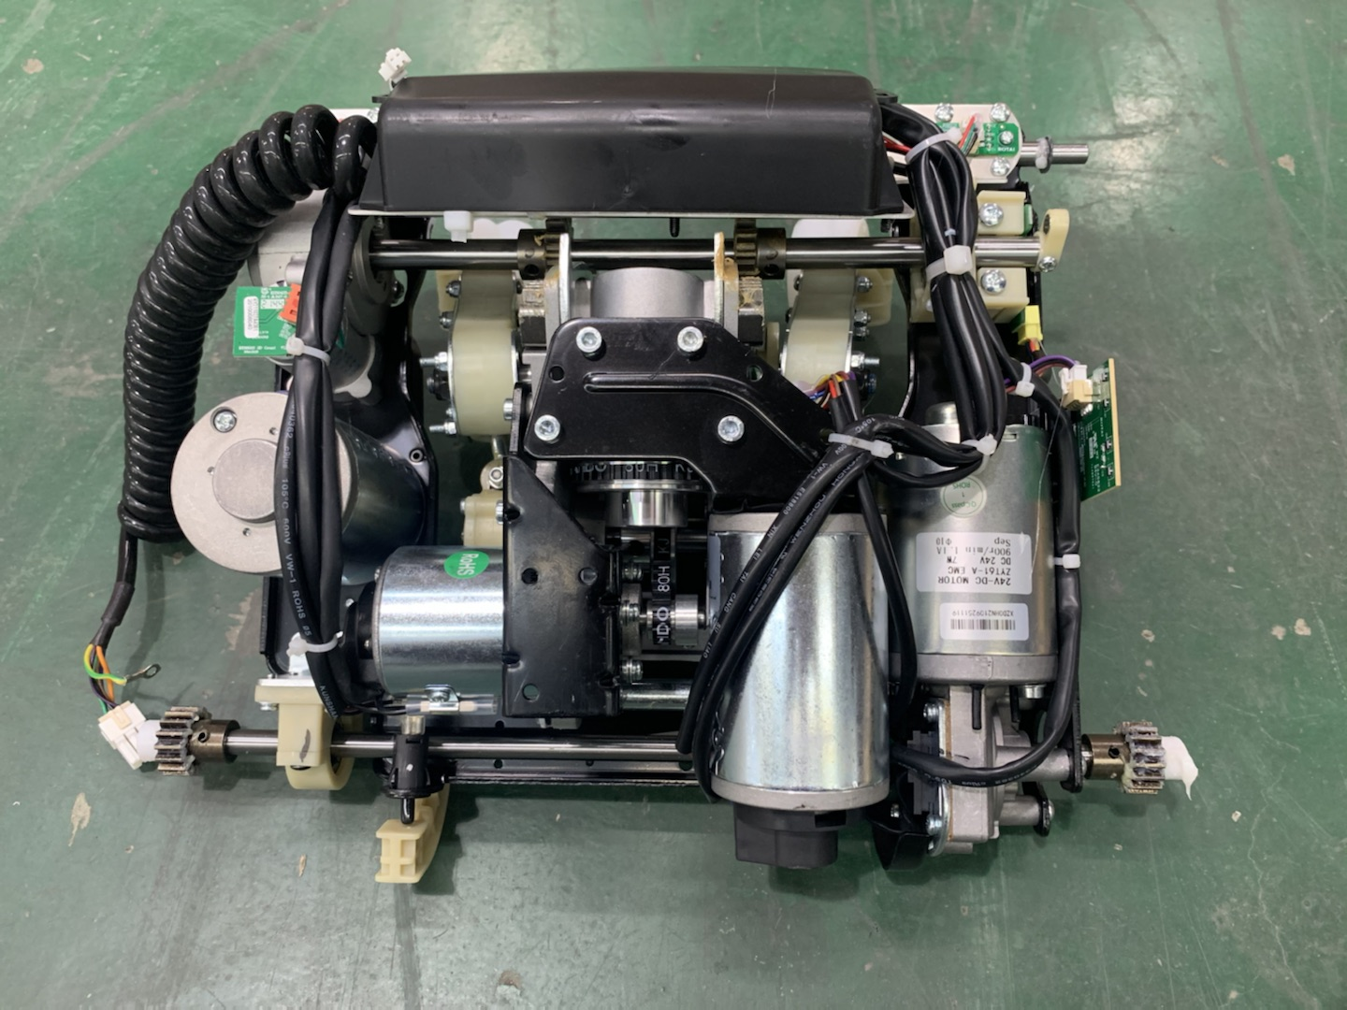
Upper Mechanism
Mechanism PCB
Widthdetect PCB
Massage force sensor
3D radial assembly
3D countPCB
3D limit PCB
3D motor
(yellow plug)
travel limit PCB
knock motor count PCB(red plug)
Anti-crash sensor
knockmotor (red plug)
knead motor count PCB(blue plug)
knead motor blue plug
walk motor(black plug

Slide 21
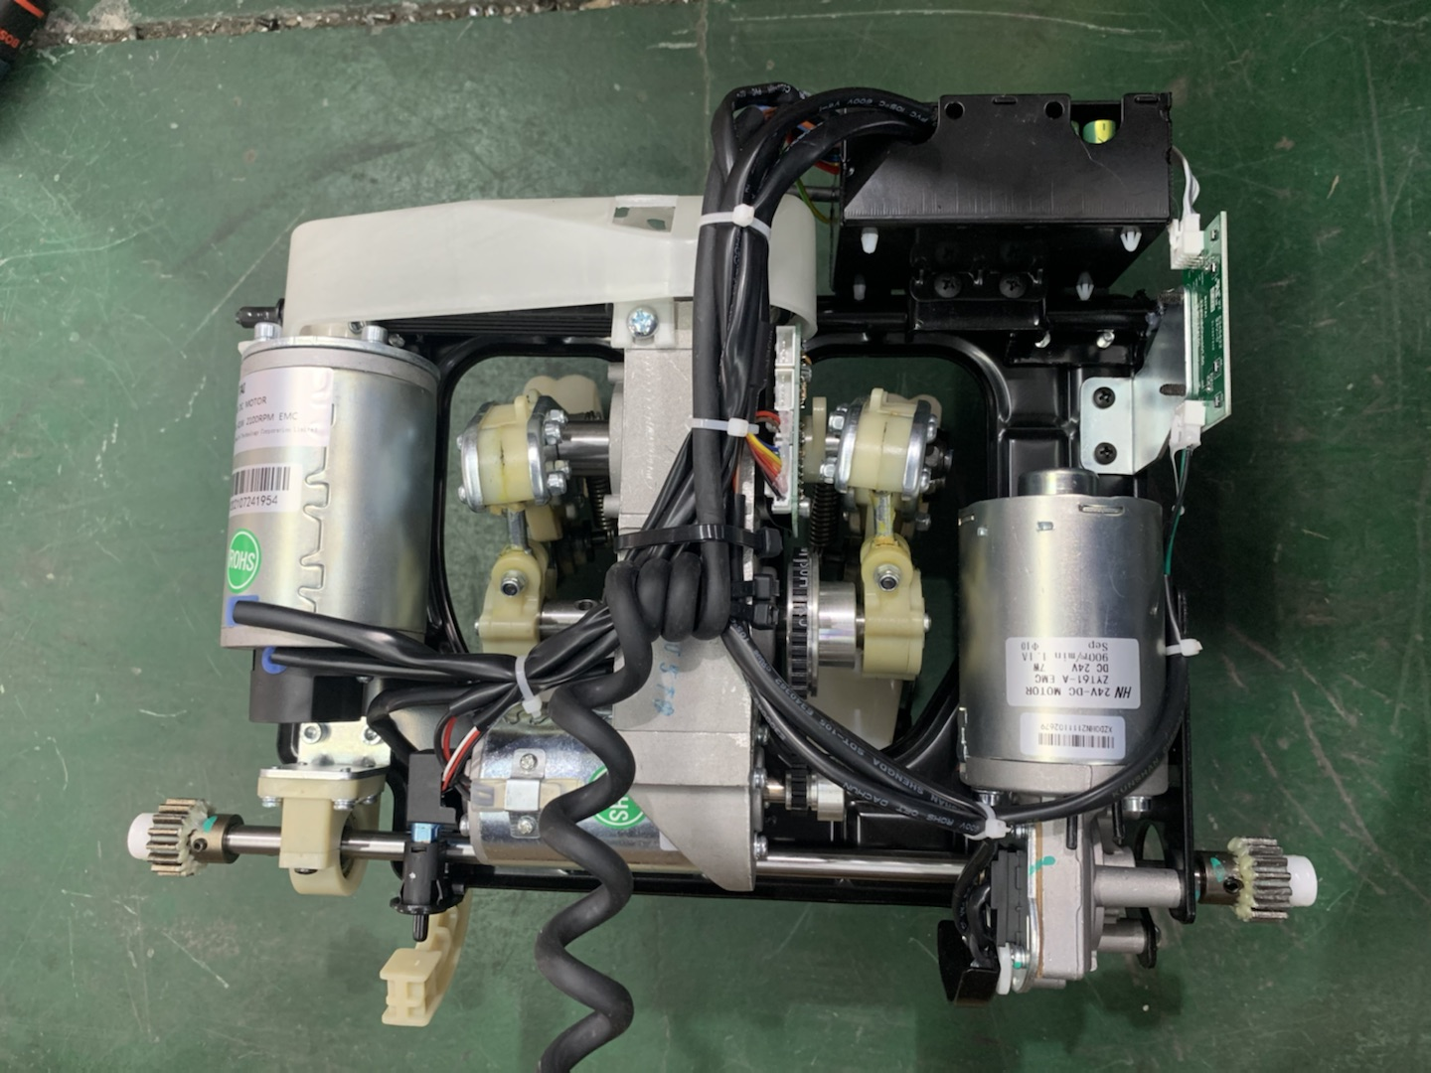
Lower Mechanism
Mechanism PCB
Width detect PCB
knead motor (blue connection)
travellimitPCB
knead motor count PCB(blue plug)
walk motor(black plug)
knock motor count PCB( red plug)
Anti-crash sensor
knock motor(red plug)
walk motor count PCB

Slide 22
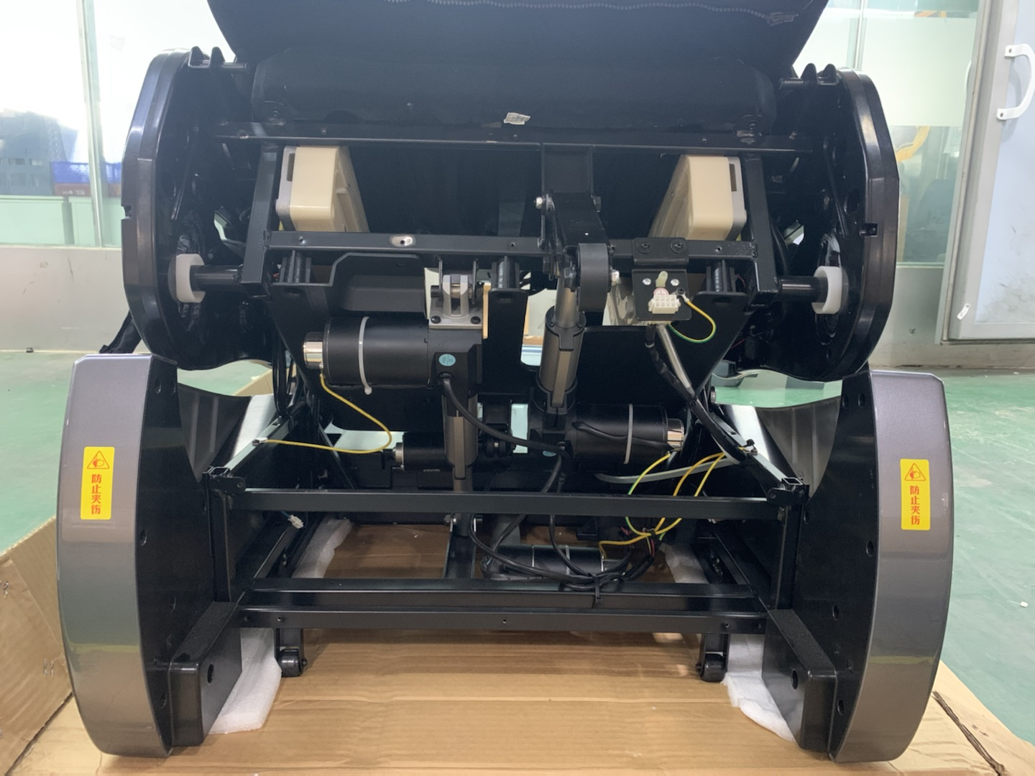
actuators
Legrest actuator(DC24V)
92MM( red plug)
Zero gravity actuator(DV24V)
111MM(blue plug)
Backrest actuator(DC24V)
76MM(white plug)
Forward actuator(DC24V)
280MM( yellow plug)
Leftsides bottom sensor PCB
Rightsides bottom sensor PCB

Slide 23
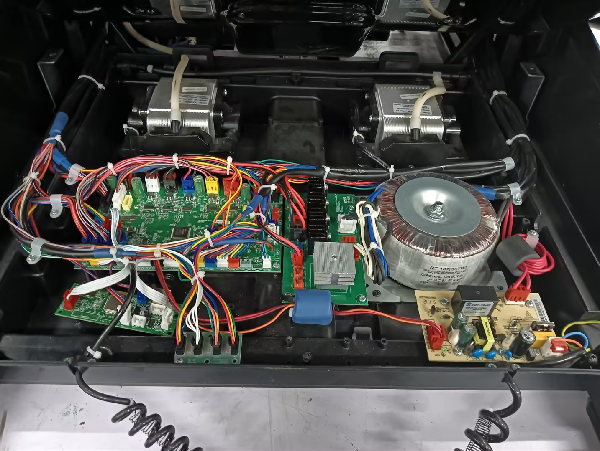
Power BOX
Armrest, shoulder, seat(upper body) airbags Bump (black plug DV24V)
Legrest Bump (white plug DC24V)
Transformer RT-116A (441W)
Main PCB
Rectifier PCB
User connecting PCB (Bluetooth PCB)
5V power PCB
Transfer PCB

Slide 24
8901 Troubleshooting
1. Tablet cannot control chair
11. Zero gravity actuator don't work
2. Fuse burned
12. Legrest rubbing don't work
3. Knead motor don’t work
13. Low Legrest don't extend
4. Mechanism no Width change
14. Legrest roller don't work
5. Knock motor don't work
15. Aigbag don’t work
6. Walk motor don't work
16. keyboard PCB don't work
7. 3D radial motor don't work
17. Wireless charging no work
8. Legrest actuator don't work
18. Failed on body scan
9. Forward actuator don't work
19. Keep body scanning
10. Backrest actuator don't work

Slide 25
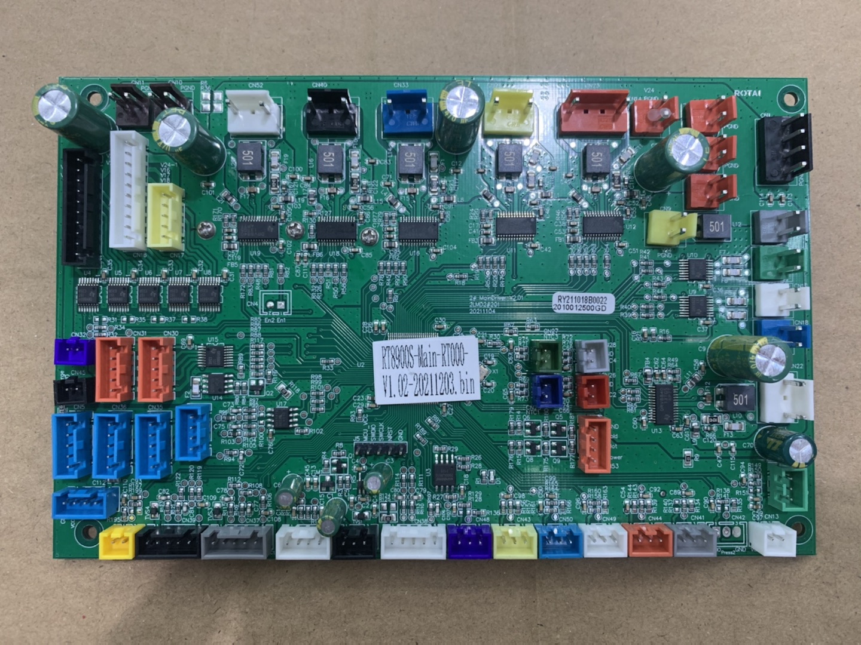
1. Tablet cannot control chair
1. Check if the chair can be powered on by remote; Check if tablet work itself;
3. If cell phone can connect with chair, check the communicaition wire between main PCB and BT board.
Remote tablet
BT board
main PCB
main PCB Comm wire to BT board
2. Check if cell phone can connect to chair via Bluetooth. If not, replace the BT board.
4. Check the communication with a multi-meter.

Slide 26
2. Fuse burned
Parts replacing order:
Fuse
Filter PCB
Power PCB
transformer
Rectifier PCB
Main PCB

Slide 27
3.Kneading motor don't work
1. Select “Sync” in manual mode, switch knead motor plug with knock motor connection on mech PCB. If kneading doesn’t work either，replace knead motor.
3. Use multimeter to check if cable connection is faulty.
knead motor faulty
Mechanism main PCB faulty
Cable between motor and mech PCB is faulty.
2. If kneading works in Step.1, then mechanism PCB is faulty.

Slide 28
4.Mechanism cannot detect Width
1. Enter into engineer mode and turn on kneading, check if data of “Width” changes. If no, replace Width PCB.
3. Check if magnet holder is fine.
Width detect PCB
knead motor count PCB
magnet holder
Cable between motor and mech PCB is faulty.
2. Enter into engineer mode and turn on kneading, check if data of “knead count” works. If no, replace knead motor.
4. Use multimeter to check if cable connection is faulty.

Slide 29
5. knocking motor don't work
1.Select “Sync” in manual mode, switch knock motor plug with knead motor plug on mech PCB, check if knocking works. If no, knock motor is faulty.
3.multimeter check cable coonection
knock motor faulty
Mechanism main PCB faulty
Regarding cable is faulty
2. If knocking works in Step.1, it means Mechanism PCB is faulty.

Slide 30
6.walking motor don't work
3. Return plugs back to original from Step.2, switch the plugs on mech PCB and run “Kneading” manually. If it walks, it means mech PCB faulty. If not, it’s cable faulty. We can use a multi-meter to test the connection of cable.
1. Connect the extra plug on mechasnim with 24V adaptor, which is direct to walk motor. If mechanism walks, motor is fine.
travel detect PCB faulty
walk motor faulty
Mechanism PCB faulty
Regarding cable is faulty
2.Select “Point” in munal and move mech with “Up/Down” on remote, if there are DD sound both moving up and down, then “travel detect PCB” is fine. Switch plugs of walk and knead motor on mechanism and run “Kneading” on remote, if the mech walks, the motor is fine.
4. Turn multimeter to “Sound” mode and test the cable if there is faulty connection.

Slide 31
7. 3D radial motor don't work
1. Select “kneading” manually, switch plug of radial motor to knead motor on Mechanism PCB. If motor don't work(mechanism cannot push forward or backward), motor is faulty.
radial motor faulty
Mechanism PCB faulty
3D travel count PCB faulty
Regarding cable is faulty
2. If it push forward/backward in Step.1, it means motor is fine and there is faulty connection on cable/plugs or mech PCB or 3D signal PCB.
4. Turn multimeter to “Sound” mode and test the cable if there is faulty connection.

Slide 32
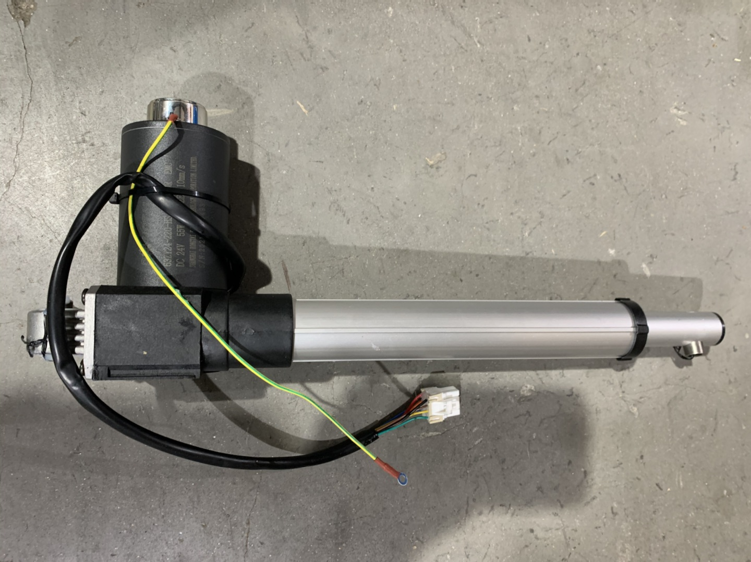
8. Legrest actuator don't work
1. Switch plugs of legrest actuator and Forward actuator, and then lift up or recline the backrest with remote. If Legrest auatuor works, then it’s fine. If no, problem is due to cable or main PCB.
3. Use multimeter to check if cable in faulty connection.
main PCB faulty
actuator faulty
Regarding cable is faulty
2. If Legrest actuator don't work in Step.1, replace it.

Slide 33
9. Forward actuator don't work
1. Switch plugs with other autuator in same way as last page. The problem is due to Actuator ifself or cable or main PCB.
3. Use multimeter to check if cable in faulty connection.
main PCB faulty
actuator faulty
Regarding cable is faulty
2. If Forward actuator don't work in Step.1, replace it.

Slide 34
10. Backrest actuator don't work
1. Same way to find problem as last page.
main PCB faulty
actuator faulty

Slide 35
11. Zero gravity actuator don't work
1. Same way to find problem as last page.
main PCBfaulty
actuatorfaulty

Slide 36
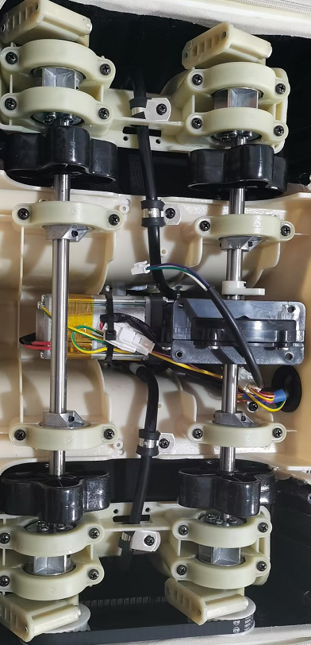
12. Calf rubbing motor don't work
1. Turn on calf rubbing, test if there is DC24V output from Legrest PCB. If no, replace main PCB.
3. Use multimeter to check if cable in faulty connection.
Legrest PCB faulty
rubbing motor faulty
Regarding cable is faulty
2. If there is DC24v output from Legrest PCB, replace the calf rubbing motor.

Slide 37
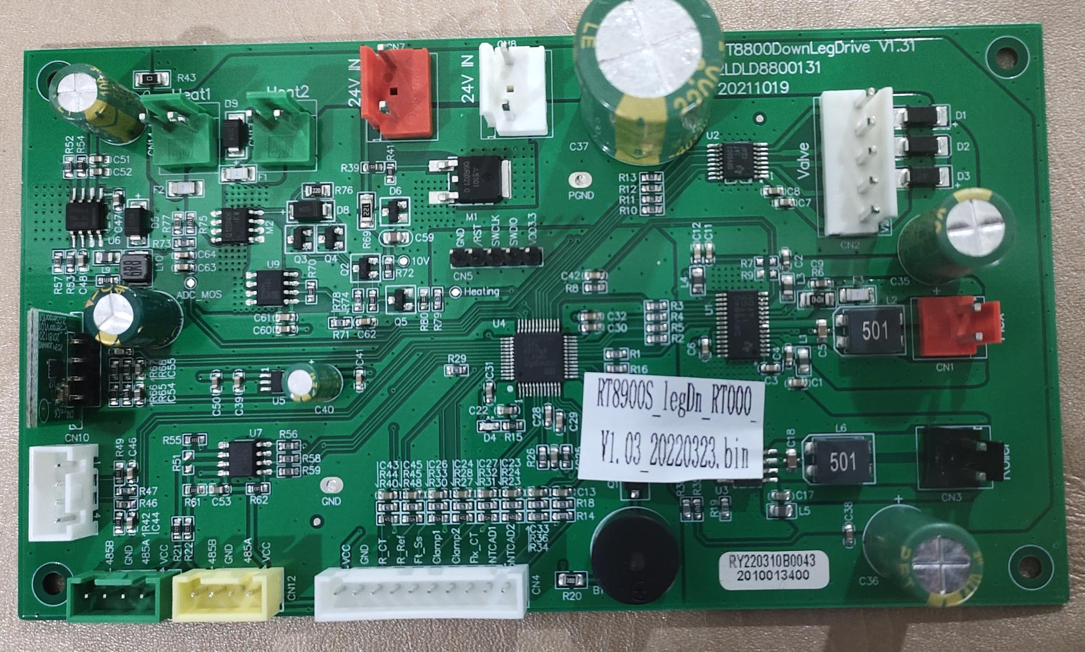
13. Legrest extension motor don't work
Lower Legrest main PCB faulty
extend motor faulty
Regarding cable is faulty

Slide 38
14. Foot roller motor don't work
Legrest PCB faulty
Roller motor faulty
Regarding cable is faulty

Slide 39
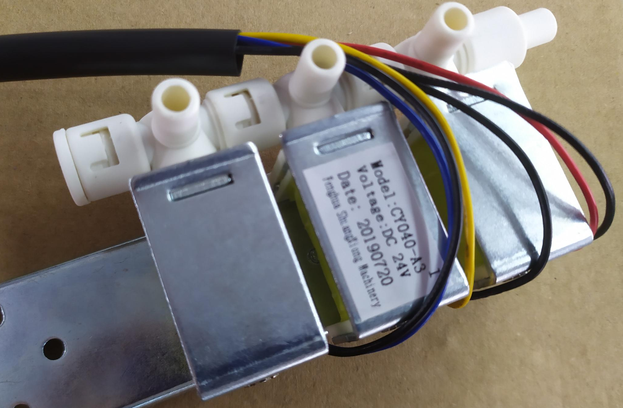
15. Airbags don’t work
3. If Bump vibrates, check if there is AC24V output from regarding joint on main PCB. If no, replace main PCB.
1. Check if air tube is blocked.
air tube
valve
main PCB
Bump
2. If air tube is fine, check the valve with multimeter. Check if resistance between black and yellow wires is in 160-170. If the difference is too much, replace the valve.
4.All airbags cannot work, check if Bump works. If no, check if AC24V output from main PCB with a multimeter. If yes, replace Bump; If no, replace main PCB.

Slide 40
16. keyboard PCB don't work
2. If main PCB supplies 5V output, replace keyboard PCB in the armrest.
main PCB
keyboard PCB
Regarding cable is faulty
1. Check if main PCB provides 5V power output. If no, replace main PCB.
3. Check if any connection is loosen on keyboard PCB connection, including plugs, joints, cables, etc.

Slide 41
17. No wireless charging
3. Check if any connection is loosen on charging PCB connection, including plugs, joints, cables, etc.
main PCB
Charging PCB
Regarding cable is faulty
1. Check if main PCB supplies DC24V power output. If no, replace main PCB.
2. Check if there is DC24V input to the charging PCB. If yes, replace cahrging PCB.

Slide 42
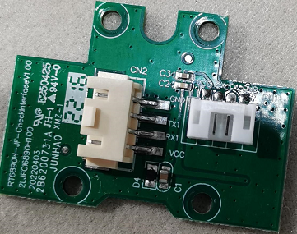
19. Health detecting cannot success
main PCB
Health detecting PCB in armrest is faulty
Regarding cable is faulty

Slide 43
20. Keep body scanning
No kneading
Mechanism Faulty
No massage Width changing
No 3D action(Mechanism cannot push forward/backward)
No walking
walk count faulty
Keep body scanning
Forwardactuator
actuator Faulty
Legrestactuator
Backrestactuator
Zero gravityactuator
Legrest faulty
Legrest cannot extend

Slide 44
Be more professional
2023/08/15

